Slide 1
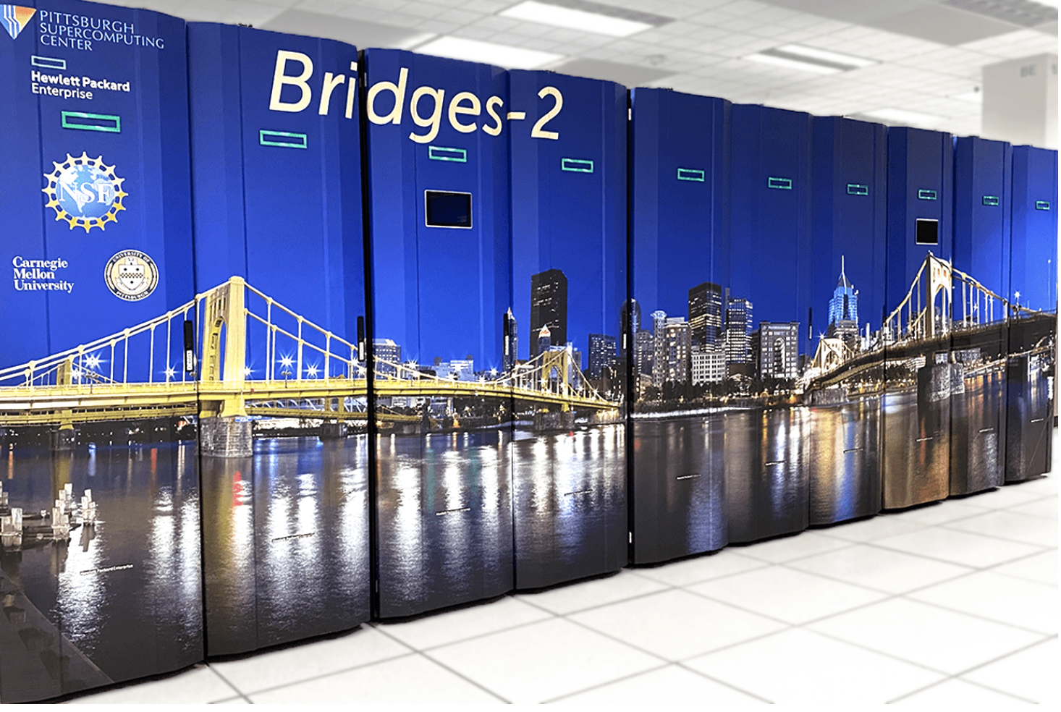
Introduction to High-Performance Computing (HPC) using the Pittsburgh Supercomputing Center Bridges-2 Supercomputer
The North Carolina School of Science and Mathematics

Slide 2
A little history…

Slide 3
ACCESS
Advanced Cyberinfrastructure Coordination Ecosystem: Services and Support
Funded by the National Science Foundation (NSF)
Podcast

Slide 4
What is it?
Access to:
high-performance computing resources
Software
Visualization engines
Specialized tools
Specialized hardware (for example, GPUs)
Significant technical support
Caveat: NO ONE should contact technical support in any way, shape, or fashion without first contacting ME!

Slide 5
Bridges supercomputer: Hardware
Hardware:
Hewlett Packard Enterprise (HPE) Integrity Superdome X servers (4, each with 12TB of RAM)
HPE Proliant DL580 servers (42, each with 3TB)
HPE Apollo 2000 servers (800, each with 128GB)
Intel® Xeon CPUs and NVIDIA Tesla GPUs for exceptional performance.
Database and web servers to support gateways, collaboration, and data management.
About Bridges-2

Slide 6
Bridges supercomputer: Software
Software listing

Slide 7
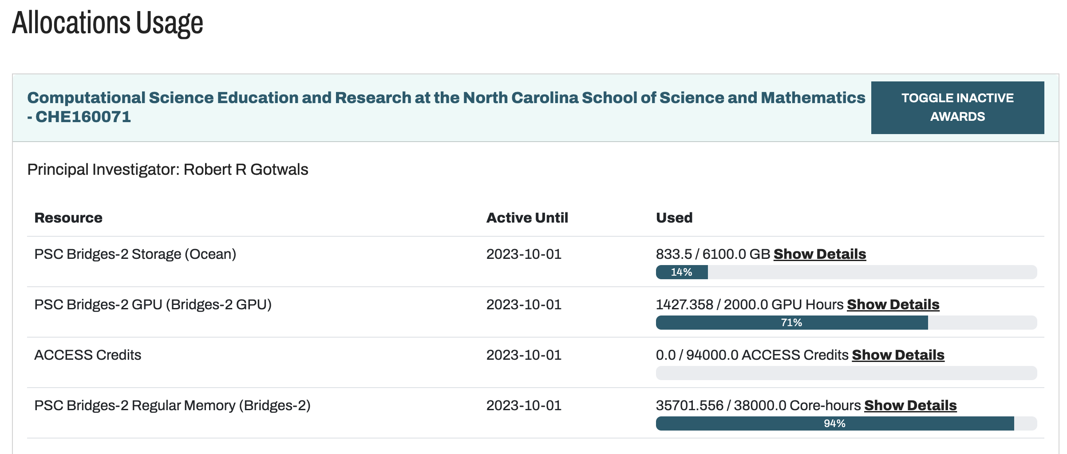
NCSSM Allocation
Education allocation, starting Year 7
PI and Allocation Manager: Robert Gotwals
Regular Memory: 38,000 core-hours
GPU allocation: 2,000 core-hours
Storage (Ocean): 6100 GB

Slide 8
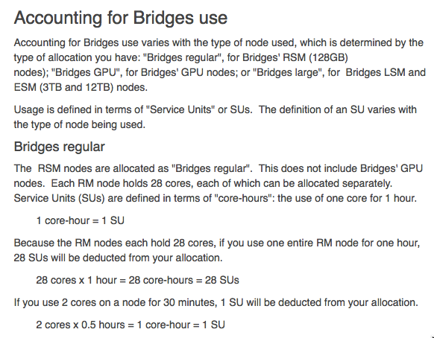
Service Units (su)

Slide 9
General Considerations
Queuing system
Supercomputing units (su) are expensive and not infinite
A serious computing resource (permission rather than forgiveness!)
Help tickets

Slide 10
End of Part 1

Slide 11
Part 2: UNIX Basics

Slide 12
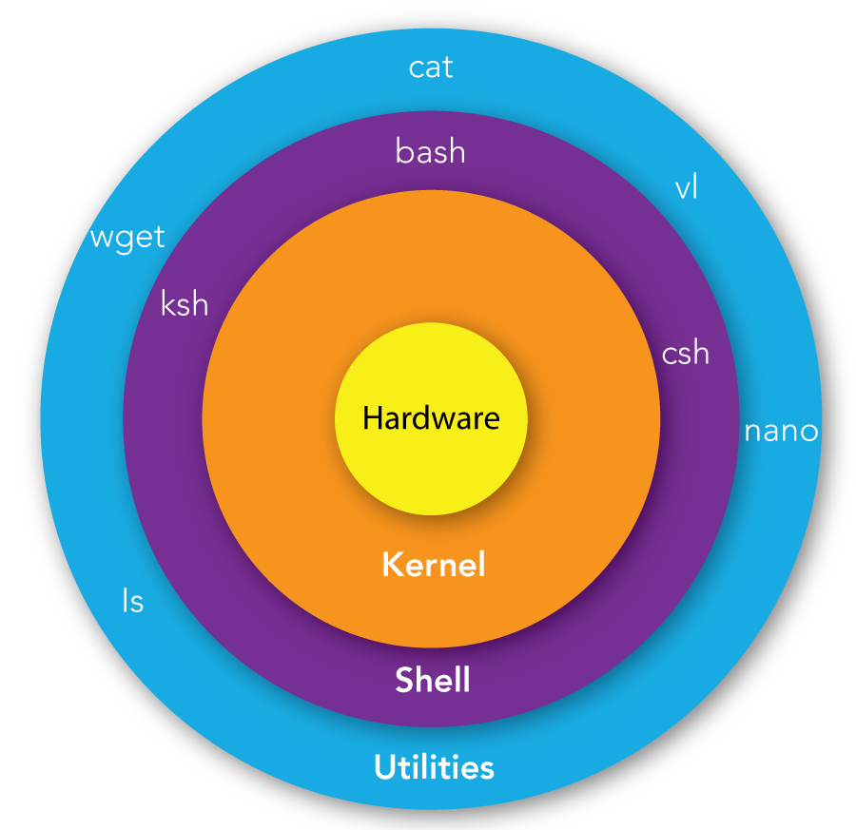
UNIX/Linux
Shells
bash
csh
ksh
tcsh
Tools
cat
ls
nano
vi

Slide 13
Sample bash script
#!/bin/bash
# Script to say "Hello world" because Gotwals is traditional!
#
# October 3, 2020
#
clear
echo "Hello, world!”
echo "Hello $USER!”
To run: bash hello.sh (may have to change permissions first!)

Slide 14
Configuring .bash_profile
Basics
Runs every time you login
Mostly establishes aliases
Create/edit with vi or nano
“dot” files are hidden files – show with ls -al
# .bash_profile
# Get the aliases and functions
if [ -f ~/.bashrc ]; then
. ~/.bashrc
fi
# User specific environment and startup programs
alias home="cd /jet/home/gotwals"
alias lsa="ls -al"
alias ocean="cd /ocean/projects/che160020p/gotwals"
alias sq="squeue -u gotwals"
alias examples="cd /opt/packages/examples"

Slide 15
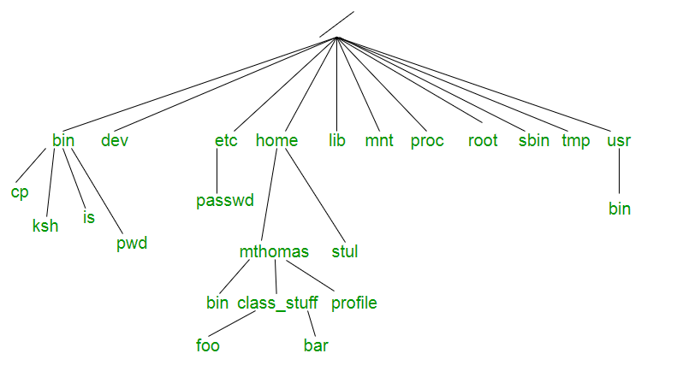
Basic UNIX
Directories
Commands
ls, ls –al
cp
rm
cd
pwd
tar
Path
/home/mthomas/class

Slide 16
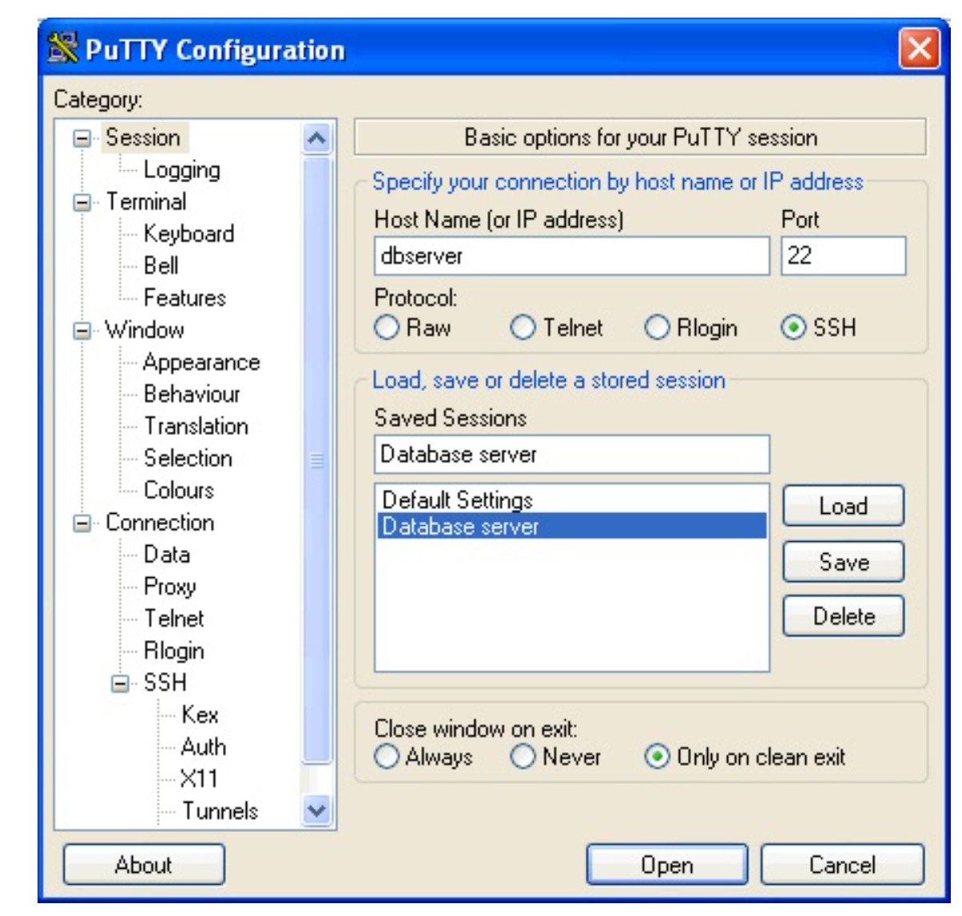
Logging on
Macs
Find “Terminal” on your machine
Type: ssh username@bridges2.psc.edu
FIRST TIME: type the word Yes to the security question
Type your password. IT WILL NOT APPEAR!
Windows users
Open “putty”
Host: bridges2.psc.edu
Connect
First time? Security message
User name and password

Slide 17
Let’s get connected!
ssh username@bridges2.psc.edu
https://ondemand.bridges2.psc.edu/
Forgot your password?
https://apr.psc.edu
Can’t connect? Check with Mr. Gotwals

Slide 18
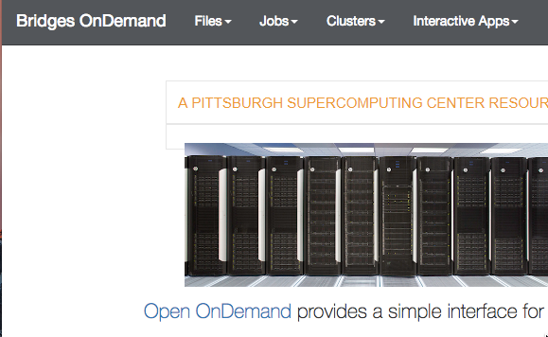
Creating/Managing Files
Interface: Bridges OnDemand

Slide 19
Job Queue

Slide 20
End of Part 2

Slide 21
Part 3: A sample calculation

Slide 22
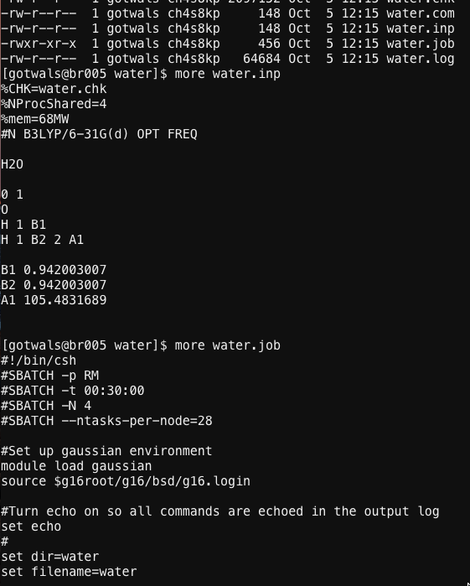
Direct/Shell
Shell access (terminal)
Requires knowledge of:
UNIX
vi (text editor)
SLURM (Simple Linux Utility for Resource Management)

Slide 23
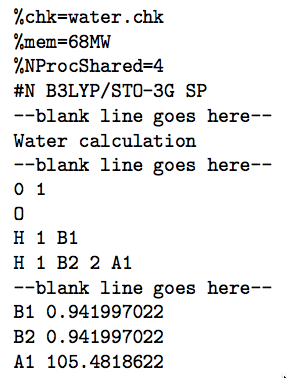
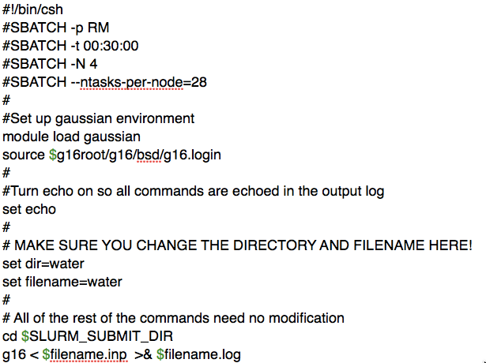
General operation
Basic steps
Create an input file
Create a job file
Submit the job file
Monitor the queue
View output/results
Backup files
Transfer back to local machine (optional)

Slide 24
Creating a basic job script

Slide 25
Job not running?
CONTACT MR. GOTWALS **FIRST**

Slide 26
End of Part 3

Slide 27
Questions?

