Slide 1
Lecture: Introduction to Computational Chemistry
Introduction to Computational Chemistry

Slide 2
Guiding Questions
What is the role and purpose of computational chemistry? What does computational chemistry allow us to do that cannot be done using "traditional" (i.e. wet ) chemistry?
What is the fundamental mathematical expression that needs to be solved in doing computational chemistry? What are the terms in this equation, what is their significance, what variations can be used?
What are the approximations that can be used in doing computational chemistry? What are the pros and cons of the various approximations? How does choice of approximation affect the results, the computing time, etc.
Introduction to Computational Chemistry

Slide 3
Questions
There are roughly four different "flavors" to computational chemistry: ab initio methods, semi-empirical methods, density functional theory (DFT) and molecular mechanics/molecular dynamics. What are these methods? How do they differ?
What are the fundamental units of measure used by computational chemists? What are some different ways that these fundamental units might be expressed?
What are some of the computer codes that one might use to do computational chemistry? What platforms are needed for these codes, what are the strengths and limitations of these codes?
Introduction to Computational Chemistry

Slide 4
PURPOSE OF COMPUTATIONAL CHEMISTRY
Introduction to Computational Chemistry

Slide 5
Computational Chemistry Defined
the branch of chemistry that uses computers to generate information that is complementary to experimental data on the structures, properties, and reactions of substances
mostly based on one algorithm: Schrodinger’s Equation
historically, computational chemistry has required use of high-performance systems
Introduction to Computational Chemistry

Slide 6
Why Computational Chemistry?
The underlying physical laws necessary for the mathematical theory of a large part of physics and the whole of chemistry are thus completely known, and the difficulty is only that the exact application of these laws leads to equations much too complicated to be soluble.
P.A.M. Dirac
1929
Introduction to Computational Chemistry

Slide 7
COMPUTATIONAL CHEMISTRY PROCEDURE
Introduction to Computational Chemistry

Slide 8
Three Things I want to know
Structure:
What does the molecule look like?
Atoms, bond lengths, bond angles, symmetry
Properties:
What characteristics does the molecule have by itself?
Molecular energy, dipole moment, structure of the molecular orbitals
QSPR: quantitative structure-property relationships
Activity:
How does the molecule behave in the presence of other molecules?
Electrostatic potential, frontier orbitals (HOMO and LUMO), nucleophilicity, electrophilicity
QSAR: quantitative structure activity relationships
Introduction to Computational Chemistry

Slide 9
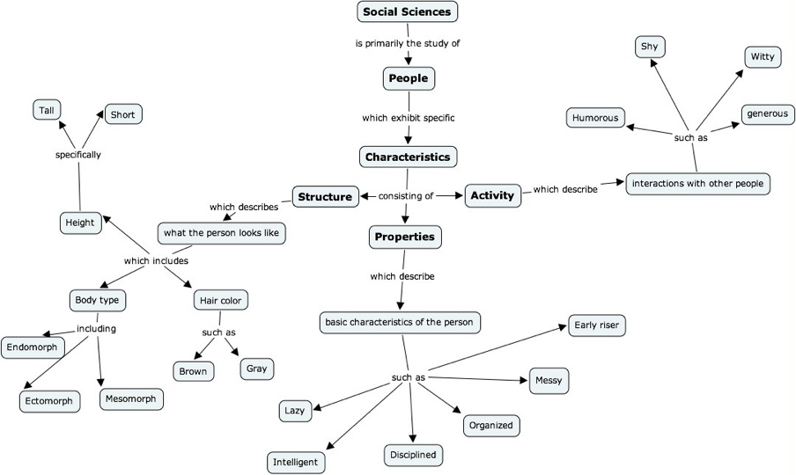
Road Map
Introduction to Computational Chemistry

Slide 10
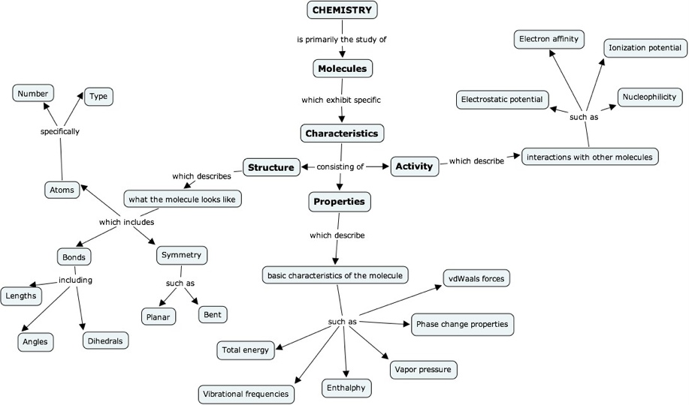
Road Map
Introduction to Computational Chemistry

Slide 11
Computational Cooking Process
CONSIDERATIONS | CHICKEN | MOLECULES
What is the shape of the chicken? Legs, breast, wing, strips?
What is the geometry of the molecule? Atoms, bonds, angles and lengths?
STARTING SHAPE: What does the thing look like?
FINAL PRODUCT: What do I want at the end?
How do I want the chicken cooked? Fried, baked, BBQ, stir-fry, etc.
What properties do I want to know? Energy, vibrations, thermodynamics, transition state
AVAILABLE TOOLS: What tools do I have to work with?
What cooking devices? Microwave, stove, oven, grill, open fire?
What computational software do I have? Gaussian, GAMESS, MOPAC, Tinker
INSTRUCTIONS: What method(s) do I have or know?
Which recipe(s) do I know or have?
Which methods do I know or have? Ab initio, semi-empirical, MM, DFT, etc.
RESOURCES: What resources do I have at my disposal?
What ingredients do I have? Sauces, spices, etc.
What type of basis sets do I know and have? Minimal, split-valence, polarized, diffuse, etc.
Introduction to Computational Chemistry

Slide 12
Questions?
Introduction to Computational Chemistry

