Slide 1
Short Course in Computational Chemistry: Introduction to Computational Chemistry
Robert R. Gotwals, Jr.
Computational Chemistry Educator
North Carolina School of Science and Mathematics
Durham, North Carolina
gotwals@ncssm.edu
Notes:
WELCOME TO THIS SHORT COURSE IN COMPUTATIONAL CHEMISTRY, PRESENTED BY THE CHEMISTRY DEPARTMENT AND THE DISTANCE EDUCATION AND EXTENSION OFFICE OF THE NORTH CAROLINA SCHOOL OF SCIENCE AND MATHEMATICS. IN THIS SHORT COURSE, WE WILL PROVIDE A FOUNDATIONAL INTRODUCTION TO THIS EXCITING TOPIC IN CHEMISTRY, WITH THE HOPES THAT YOU WILL BE ABLE TO EXPLORE AND ENGAGE IN A MORE IN-DEPTH STUDY OF COMPUTATIONAL CHEMISTRY THROUGH OTHER OPPORTUNITIES, WHETHER IT BE IN A COLLEGE COURSE, AN ONLINE RESOURCE, OR YOUR OWN SELF-STUDY. SO LET’S GET STARTED!
----- Meeting Notes (6/26/17 09:13) -----

Slide 2
Guiding Questions
What is the role and purpose of computational chemistry? What does computational chemistry allow us to do that cannot be done using "traditional" (i.e. wet ) chemistry?
What is the fundamental mathematical expression that needs to be solved in doing computational chemistry? What are the terms in this equation, what are their significance, what variations can be used?
What are the approximations that can be used in doing computational chemistry? What are the pros and cons of the various approximations? How does choice of approximation affect the results, the computing time, etc.
There are roughly four different methods in computational chemistry: ab initio methods, semi-empirical methods, density functional theory (DFT) and molecular mechanics/molecular dynamics. What are these methods? How do they differ?
What are the fundamental units of measure used by computational chemists? What are some different ways that these fundamental units might be expressed?
What are some of the computer codes that one might use to do computational chemistry? What platforms are needed for these codes, what are the strengths and limitations of these codes?
Notes:
COMPUTATIONAL CHEMISTRY IS A RICH AND SOMETIMES COMPLICATED AREA OF STUDY, SO FOR THIS SHORT COURSE WE’VE ATTEMPTED TO SIMPLIFY ITS STUDY BY SUGGESTING SIX TOPIC AREAS THAT YOU SHOULD KNOW AS A STUDENT OF COMPUTATIONAL CHEMISTRY. FIRST YOU SHOULD BE ABLE TO DESCRIBE THE ROLE AND PURPOSE OF COMPUTATIONAL CHEMISTRY. WHAT DOES COMPUTATIONAL CHEMISTRY ALLOW YOU TO DO THAT YOU MIGHT NOT BE ABLE TO DO IN A TRADITIONAL, OR WET, CHEMISTRY LAB? SECOND, YOU SHOULD BE ABLE TO DESCRIBE THE FUNDAMENTAL MATHEMATICAL EQUATION THAT IS BEING SOLVED WHEN YOU ARE DOING COMPUTATIONAL CHEMISTRY. IN A LONGER COURSE, WE WOULD SPEND A CONSIDERABLE AMOUNT OF TIME LOOKING AT THE FOUNDATIONAL MATHEMATICS, BUT IN THIS SHORT COURSE WE’LL ONLY PROVIDE A BROAD OVERVIEW OF COMPUTATIONAL CHEMISTRY MATHEMATICS. THIRD, BASED ON YOUR BASIC UNDERSTANDING OF THE UNDERLYING MATHEMATICS, YOU SHOULD UNDERSTAND SOME OF THE APPROXIMATIONS TO THAT MATHEMATICS THAT WE USE IN ORDER TO BE ABLE TO RUN OUR CALCULATIONS IN A REASONABLE AMOUNT OF TIME, AND HOW THOSE APPROXIMATIONS INFLUENCE THE ACCURACY OF OUR RESULTS. FOURTH, BY THE END OF THIS COURSE YOU SHOULD BE ABLE TO DESCRIBE THE FOUR BASIC METHODS USED IN COMPUTAITONAL CHEMISTRY: AB INITIO METHODS, SEMI-EMPIRICAL METHODS, DENSITY FUNCTIONAL THEORY OR DFT, AND MOLECULAR MECHANICS/MOLECULAR DYNAMICS OR MM/MD. YOU SHOULD BE ABLE TO DESCRIBE HOW AND WHEN ONE METHOD MIGHT BE USED AND IN WHAT SITUATIONS. FIFTH, COMPUTATIONAL CHEMISTS USE SOME OF THE SAME UNITS AS EXPERIMENTAL CHEMISTS, SUCH AS KCAL PER MOLE AS UNIT OF ENERGY, BUT THEY HAVE SOME OF THEIR OWN UNITS, SUCH AS HARTREES. HAVING AN UNDERSTANDING OF THESE UNITS AND HOW TO CONVERT THEM SO THAT YOU CAN COMPARE YOUR COMPUTATIONAL RESULTS WITH THOSE OF YOUR EXPERIMENTAL COLLEAGUES IS IMPORTANT. FINALLY, YOU SHOULD BE ABLE TO DESCRIBE DIFFERENT SOFTWARE PACAKGES OR COMPUTER CODES THAT ARE USED IN COMPUTATIONAL CHEMISTRY. THE PRIMARY SOFTWARE PACKAGE USED IN THIS SHORT COURSE IS GAUSSIAN, A COMMERCIAL CODE THAT IS PROBABLY THE INDUSTRY STANDARD FOR THE FIELD. YOU’LL LEARN ABOUT GAUSSIAN AND OTHER CODES, AND DEVELOP AN UNDERSTANDING OF THEIR STRENGTHS AND WEAKNESSES.

Slide 3
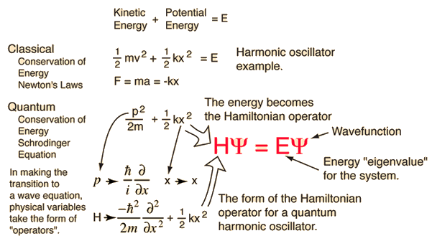
Computational chemistry defined
the branch of chemistry that uses computers to generate information that is complementary to experimental data on the structures, properties, and reactions of substances
Mostly based on one equation: Schrodinger’s Equation
Source: http://hyperphysics.phy-astr.gsu.edu/
Notes:
OK, LET’S START WITH A BASIC DEFINITION OF COMPUTATIONAL CHEMISTRY. AS YOU CAN SEE ON THE SLIDE, WE DEFINE COMPUTATIONAL CHEMISTRY AS THAT BRANCH OF CHEMISTRY THAT USES COMPUTERS TO GENERATE INFORMATION THAT IS COMPLEMENTARY TO EXPERIMENTAL DATA ON THE STRUCTURES, PROPERTIES, AND REACTIONS OF SUBSTANCES OR MOLECULES. IT’S IMPORTANT TO FOCUS ON THE WORD “COMPLEMENTARY”. WHILE COMPUTATIONAL IS ITS OWN DISCIPLINE OR SUB-UNIT OF CHEMISTRY AS COMPARED TO EXPERIMENTAL, OR WET CHEMISTRY, ONE OF ITS GOALS IS TO BE ABLE TO REPLICATE THE EXPERIMENTAL DATA GENERATED IN THE WET LAB. WE CAN USE COMPUTATIONAL CHEMISTRY TO VALIDATE THE FINDINGS FROM A TRADITIONAL LAB, OR WE CAN USE COMPUTATIONAL CHEMISTRY TO GUIDE THE EXPERIMENTALIST IN HIS OR HER WORK IN THE LABORATORY. FOR EXAMPLE, USING COMPUTATIONAL CHEMISTRY, WE CAN TELL THE EXPERMENTAL CHEMISTRY THAT THE LIKELIHOOD OF A REACTION BEHAVING AS EXPECTED IS LOW OR HIGH. BASED ON COMPUTATIONS, THE EXPERIMENTALIST MIGHT THEN BE ABLE TO DECIDE IF THE STUDY OF THAT REACTION EXPERIMENTALLY IS WORTH THE TIME, EFFORT, AND EXPENSE. EXPERIMENTAL AND COMPUTATIONAL CHEMISTRY ARE OFTEN SEEN AS TWO SIDES OF THE SAME COIN, BUT IT’S IMPORTANT FOR YOU AS A COMPUTATIONAL CHEMIST TO UNDERSTAND THE CLOSE, SYMBIOTIC RELATIONSHIP BETWEEN EXPERIMENTALIST AND COMPUTATIONALIST. IN MANY SITUATIONS, ALTHOUGH THIS IS IMPROVING, IT’S OFTEN YOUR JOB AS A COMPUTATIONALIST TO HELP THE EXPERMENTALIST UNDERSTAND HOW YOUR CALCULATIONS AND COMPUTATIONS WILL IMPROVE THEIR ABILITY TO CONDUCT THEIR EXPERIMENTS!
COMPUTATIONAL CHEMISTRY IS BASED ON ONE CENTRAL EQUATION, KNOWN AS SCHRODINGER’S EQUATION, DEVELOPED BY PHYSICIST ERWIN SCHRODINGER IN 1925. THIS EQUATION IS ONE OF THE FOUNDATIONAL MATHEMATICAL EQUATIONS OF THE EARLY 20TH CENTURY, WHICH WAS THE GOLDEN ERA OF QUANTUM MECHANICS, WITH SCIENTISTS SUCH AS ALBERT EINSTEIN, PAUL DIRAC, NIELS BOHR, MAX PLANCK, AND WERNER HEISENBERG. THE GRAPHIC IN THE SLIDE WORKS TO RELATE CLASSICAL NEWTONIAN LAWS WITH QUANTUM BEHAVIOR. IN CLASSICAL MECHANICS, WE CAN DESCRIBE THE ENERGY OF A SYSTEM BY CONSIDERING ITS KINETIC ENERGY AND ITS POTENTIAL ENERGY, EQUATIONS YOU LIKELY ENCOUNTERED IN A HIGH SCHOOL OR COLLEGE COURSE IN PHYSICS. IN THE EXAMPLE IN THE GRAPHIC, WE HAVE A SMALL SYSTEM, A HARMONIC OSCILLATOR, AND WE CAN DESCRIBE THE ENERGY OF THAT SYSTEM BY CALCULATING ITS KINETIC AND POTENTIAL ENERGIES. WE CAN ALSO DETERMINE THE FORCE, PRIMARILY USING HOOKE’S LAW F EQUALS NEGATIVE K TIMES X, WHERE K IS THE SPRING CONSTANT AND X IS ITS POSITION. IN QUANTUM MECHANICS, THE ENERGY BECOMES WHAT IS KNOWN AS A HAMILTONIAN OPERATOR, H. SCHRODINGER’S EQUATION DESCRIBES THE CONSERVATION OF ENERGY IN THE SYSTEM BY DESCRIBING THE WAVEFUNCTION, REPRESENTED BY THE GREEK LETTER PSI. THE OVERALL EQUATION IS KNOWN AS AN EIGENFUNCTION, AND WHEN WE APPLY THE HAMILTONIAN OPERATOR TO A WAVEFUNCTION, WE GET A CONSTANT E, WHICH IS THE ENERGY OF THE SYSTEM. YOU SHOULD NOT BE WORRIED IF THIS IS CONFUSING, EVEN THE GREAT PHYSICIST RICHARD FEYNMAN SAID NOBODY REALLY UNDERSTANDS QUANUTM MECHANICS. REGARDLESS, WE’LL TALK MORE ABOUT THE MATHEMATICS IN SCHRODINGER’S EQUATION LATER IN THE COURSE.

Slide 4
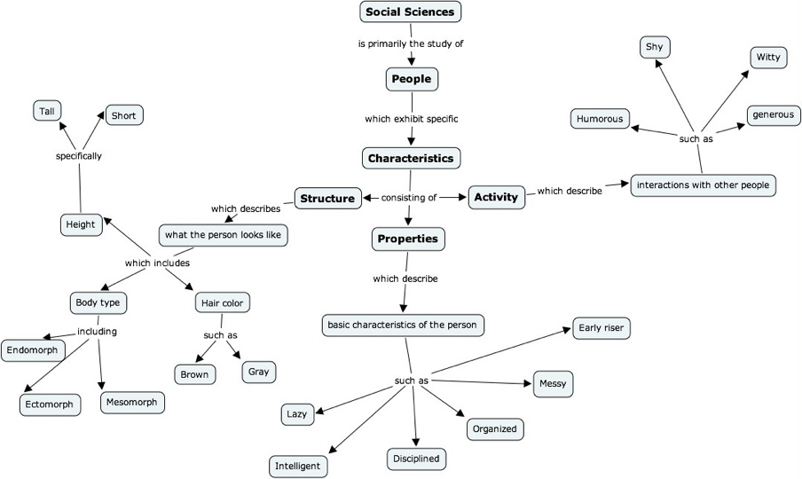
Road Map…
Notes:
TO TRY TO HELP PROVIDE SOME TYPE OF ROAD MAP TO THE REST OF THIS COURSE, WE’LL USE AN ANALOGY BETWEEN THE STUDY OF PEOPLE – SOCIAL SCIENCE – AND THE STUDY OF MOLECULES – CHEMISTRY. LET’S TAKE A LOOK FIRST AT THE SIMPLE, AND PERHAPS SIMPLISTIC, ROAD MAP OF THE STUDY OF SOCIAL SCIENCES. SOCIAL SCIENCES IS PRIMARILY THE STUDY OF PEOPLE. PEOPLE EXHIBIT CHARACTERISTICS, WHICH WE HAVE SUBDIVIDED INTO THREE CATEGORIES. FIRST OF ALL, PEOPLE HAVE STRUCTURE, WHICH DESCRIBES WHAT THEY LOOK LIKE. THEY CAN HAVE VARIOUS BODY TYPES, SUCH AS ENDOMORPH OR ECTOMORPH. THEY CAN HAVE VARIOUS HAIR COLOR, CAN BE DIFFERENT HEIGHTS. THERE ARE CERTAINLY OTHER DESCRIPTORS AND PHYSICAL CHARACTERISTICS WE COULD ADD TO THIS PART OF THE MAP, BUT YOU GET THE IDEA. PEOPLE ALSO HAVE PROPERTIES, WHICH WE DEFINE AS THEIR BASIC CHARACTIERISTICS. SOME EXAMPLES ARE THAT THEY ARE LAZY, THAT THEY ARE INTELLIGENT, THEY ARE DISCIPLINED, ORGANIZED, MESSY, OR AN EARLY RISER. OF PARTICULAR IMPORTANCE HERE IS THAT A PERSON HAS THESE CHARACTERISTICS ALL THE TIME, WHETHER THEY ARE ALONE OR WITH OTHER PEOPLE. SO EVEN IF THEY ARE A HERMIT ON A DESERTED ISLAND, THEY WOULD HAVE THESE CHARACTERISTICS. CONVERSELY, WE HAVE WHAT WE ARE CALLING, FOR LACK OF A BETTER TERM, A PERSON’S ACTIVITY. THESE ARE DEFINED AS CHARACTERISTICS THAT ARE ONLY RELEVANT IN THE PRESENCE OF OTHER PEOPLE. SOME EXAMPLES INCLUDE BEING HUMEROUS, BEING GENEROUS, BEING SHY OR WITTY. NONE OF THESE CHARACTERISTICS WOULD MAKE ANY SENSE IF THE PERSON IS ON THE DESERTED ISLAND, THEY ONLY MAKE SENSE IN THE CONTEXT OF THE PERSON’S INTERACTION WITH OTHER PEOPLE.

Slide 5
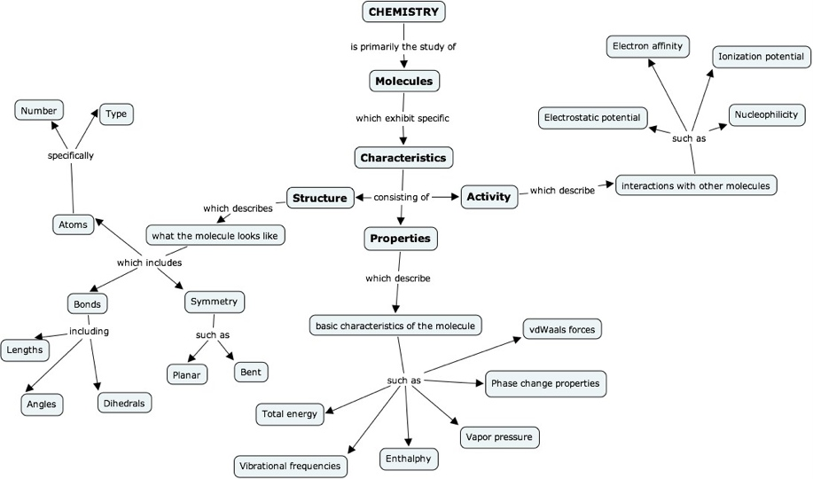
Road Map…
Notes:
WE NOW MAKE AN ANALOGY BETWEEN THE SOCIAL SCIENCES AND CHEMISTRY. CHEMISTRY IS THE STUDY OF MOLECULES, JUST AS SOCIAL SCIENCE IS THE STUDY OF PEOPLE. LIKE PEOPLE, MOLECULES HAVE THE CHARACTERISTICS OF STRUCTURE, PROPERTIES, AND ACTIVITY. IN TERMS OF STRUCTURE, WE CARE ABOUT WHAT THE MOLECULE LOOKS LIKE, AND WE CAN DESCRIBE MOLECULAR STRUCTURE IN TERMS OF WHAT TYPE AND NUMBER OF ATOMS IT HAS, WHAT TYPE AND NUMBER OF BONDS IT MIGHT HAVE BETWEEN ATOMS, AND PERHAPS IT’S MOLECULAR SYMMETRY, USING TERMS SUCH AS PLANAR OR BENT. LIKEWISE, WE CAN DESCRIBE THE PROPERTIES OF A MOLECULE, THOSE PROPERTIES THAT A MOLECULE HAS IN ISOLATION FROM ANY OTHER MOLECULE. A MOLECULE HAS ENERGY, IT VIBRATES AT SPECIFIC FREQUENCIES, IT HAS AN ENTHALPY VALUE, IT CAN EXIST IN DIFFERENT PHASES, AND THE LIKE. FINALLY, MOLECULES HAVE ACTIVITY, WHICH IS PROBABLY BETTER DESCRIBED BY THE TERM REACTIVITY. THESE ARE THE INTERACTIONS THAT A MOLECULE HAS WITH OTHER MOLECULES, AND WE CAN DESCRIBE THAT ACTIVITY IN TERMS OF DESCRIPTORS SUCH AS ELECTROSTATIC POTENTIAL AND NUCLEOPHILICITY. IF, AS A CHEMISTY, YOU CAN DESCRIBE A MOLECULE IN TERMS OF ITS STRUCTURE, PROPERTIES, AND ACTIVITIES, IT’S SAFE TO SAY THAT YOU KNOW A GREAT DEAL ABOUT THAT MOLECULE.

Slide 6
Three things I want to know
Structure:
What does the molecule look like?
Atoms, bond lengths, bond angles, dihedral angles, symmetry
Properties:
What characteristics does the molecule have by itself?
Molecular energy, dipole moment, structure of the molecular orbitals
Activity:
How does the molecule behave in the presence of other molecules?
Electrostatic potential, frontier molecular orbitals (HOMO/LUMO), nucleophilicity, electrophilicity
QSPR/QSAR:
Quantitative structure-property relationship
Quantitative structure-activity relationship
Notes:
THIS SLIDE SUMMARIZES THE THREE THINGS, AT THE MOST BASIC LEVEL, THAT I WANT TO KNOW ABOUT AN INDIVIDUUAL MOLECULE. IN TERMS OF ACTIVITY, ONE STATISTICAL METHOD USED IS KNOWN AS QUANTITATIVE STRUCTURE-PROPERTY RELATIONSHIPS, OR QUANTITATIVE STRUCTURE-ACTIVITY RELATIONSHIPS. THIS IS A STATISTICAL TECHNIQUE THAT SAYS THAT THERE IS A MATHEMATICAL RELATIONSHIP BETWEEN SOME STRUCTURAL CHARACTERISTIC OF A MOLECULE AND SOME PROPERTY OR ACTIVITY OF THAT MOLECULE. FOR EXAMPLE, IT IS THE CASE THAT THERE IS A RELATIONSHIP BETWEEN THE GAP OF THE HIGHEST OCCUPIED MOLECULAR ORBITAL, OR HOMO, AND THE LOWEST UNOCCUPIED MOLECULAR ORBITAL, OR LUMO, AND THE VALUE OF THE PROPERTY OF PKA IN A MOLECULE. SO, IF YOU CAN DETERMINE THE SIZE OF THE HOMO/LUMO GAP, YOU CAN THEN SAY SOMETHING INTELLIGENT ABOUT THE PKA FOR THAT PARTICULAR MOLECULE.

Slide 7
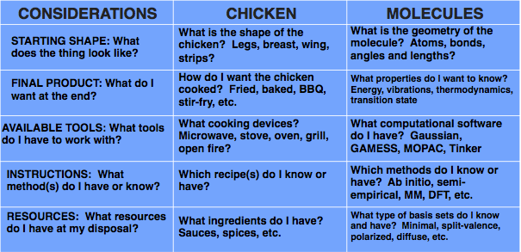
Computational cooking…
Notes:
IN THIS SLIDE, WE TRY TO MAKE AN ANALOGY BETWEEN A COOK AND A COMPUTATIONAL CHEMIST. SUPPOSE, FOR EXAMPLE, THAT YOU WORK AT KENTUCKY FRIED CHICKEN AS A CHICKEN CHEF. IF YOU ARE A CHICKEN CHEF, THERE ARE PROBABLY FIVE THINGS YOU NEED TO CONSIDER. FIRST, WHAT INGREDIENTS DO YOU HAVE? DO YOU HAVE LEGS, BREASTS, WINGS, OR THIGHS? DO YOU HAVE STRIPS? KNOWING THE STARTING MATERIALS IS PRETTY IMPORTANT. SECOND, WHAT FINAL PRODUCT DO YOU DESIRE? DO YOU WANT FRIED CHICKEN? BARBEQUE CHICKEN? BAKED CHICKEN? UNLESS YOU KNOW WHAT THE FINAL PRODUCT SHOULD BE, IT’S PRETTY HARD TO KNOW HOW TO PROCEED. THIRD, YOU HAVE TO KNOW WHAT TOOLS YOU HAVE AVAILABLE. IF ALL YOU HAVE IS A MICROWAVE, YOUR OPTIONS FOR THE TYPE OF CHICKEN YOU CAN MAKE IS PROBABLY PRETTY LIMITED. IF, HOWEVER, YOU HAVE A VARIETY OF TOOLS, SUCH AS A STOVE, AN OVEN, PERHAPS AN OUTDOOR GRILL, THEN YOU HAVE A LOT MORE OPTIONS AND POSSIBILITIES. FINALLY, WHAT AND HOW YOU COOK DEPENDS ON WHAT OTHER RESOURCES YOU MIGHT HAVE, SUCH AS DIFFERENT SAUCES OR SPICES. THE MORE YOU HAVE, THE MORE OPTIONS YOU HAVE IN TERMS OF PREPARING CHICKEN.
DOING COMPUTATIONAL CHEMISTRY IS HARDER THAN COOKING CHICKEN, BUT THE QUESTIONS ARE STILL THE SAME. WHAT INGREDIENTS DO YOU HAVE? WHAT ATOMS ARE AVAILABLE FOR STUDY – DEPENDING ON THE SOFTWARE PACKAGE, YOU MIGHT NOT HAVE EVERY ATOM ON THE PERIODIC TABLE. HOW ARE THOSE ATOMS ARRANGED? HOW MANY DO YOU HAVE. WHAT DO YOU WANT TO LEARN FROM YOUR CALCULATION? WHAT DOES THE CALCULATION TASTE LIKE AT THE END, SO FOR EXAMPLE, CAN YOU NOW SEE THE VIBRATIONS OF THE MOLECULE, OR THE ENERGY OR THE THERMODYNAMIC STATE. IN TERMS OF TOOLS, WHAT SOFTWARE DO YOU HAVE AT YOUR DISPOSAL? GAUSSIAN? MOPAC? SOMETHING ELSE. IN TERMS OF INSTRUCTIONS, WHAT METHODS DO YOU KNOW HOW TO USE? DO YOU KNOW AB INITIO METHODS? DENSITY FUNCTIONAL THEORY? BOTH? DO YOU KNOW OTHER METHODS? AND FINALLY, WHAT SPICES OR SAUCES DO YOU HAVE, WHICH IS ANALOGOUS TO WHAT TYPE OF BASIS SETS. MAYBE YOU ONLY HAVE ACCESS TO MINIMAL BASIS SETS, OR PERHAPS YOU HAVE THE FULL CATALOG OF 600 OR MORE DIFFERENT BASIS SETS FROM WHICH TO CHOOSE. SO WHEN YOU ARE THINKING ABOUT SOLVING A PROBLEM WITH A COMPUTATIONAL APPROACH, MAKE SURE YOU CAN ANSWER THESE FIVE QUESTIONS: STARTING SHAPE, FINAL PRODUCT, AVAILABLE TOOLS, INSTRUCTIONS, AND RESOURCES. IT WILL HELP YOU MAKE SOME SENSE OF SOME OF THE VERY COMPLICATED CONCEPTS AND DECISIONS YOU NEED TO MAKE AS A COMPUTATIONAL CHEMIST.

Slide 8
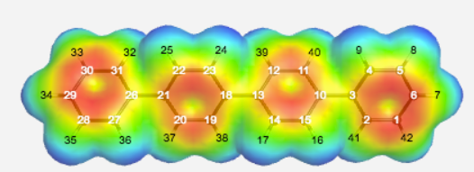
Next…applications in computational chemistry
Notes:
THIS CONCLUDES THIS INTRODUCTION TO THE WORLD OF COMPUTATIONAL CHEMISTRY. IN THE NEXT SESSION, WE’LL TALK ABOUT SPECIFIC WAYS IN WHICH COMPUTATIONAL CHEMISTRY IS USED TO STUDY INTERESTING AND RELEVANT PROBLEMS IN CHEMISTRY. HOPE YOU WILL JOIN US FOR APPLICATIONS IN COMPUTATIONAL CHEMISTRY, COMING UP NEXT!

